Slide 1

“Grocery Delivery Website”
Task - 5

Slide 2
Grocery Website
The Online Grocery Delivery Website project aims to revolutionize the way consumers shop for groceries by providing a convenient and efficient online platform for ordering and delivering groceries.
LMS Username | Name | Batch
au721220104002 | Anburaj G | CD1_8
au721220104030 | Prakash G | CD1_8
au721220104031 | Praveen P | CD1_8
au721220104061 | Vimal R | CD1_8

Slide 3
Task – 5
Creation of web page and Live Link
Create back end using Java
Upload this task in GitHub
Add repository link in your task-5 PPT
Evaluation Metric:
100% Completion of the above tasks

Slide 4
Step-Wise Description
Front-End Development: HTML, CSS, JavaScript
Back-End Development: Python,Java
Summary of your task
It involves the development of a comprehensive grocery delivery website that aims to provide a convenient and efficient solution for customers to purchase groceries online and have them delivered to their doorstep.
The goals are to enhance the customer experience, optimize supply chain management, and establish a reliable and scalable grocery delivery service that aligns with evolving consumer preferences and market demands.

Slide 5
Assessment Parameter
Gather requirements for the project
add Readme.md file with description of the project
Prepare database design schemas
Check-List
Commit all changes with "first commit"
Get your initial project Structure ready
create a repository on github related to project
Initiate a git repository
Push your changes to github

Slide 6
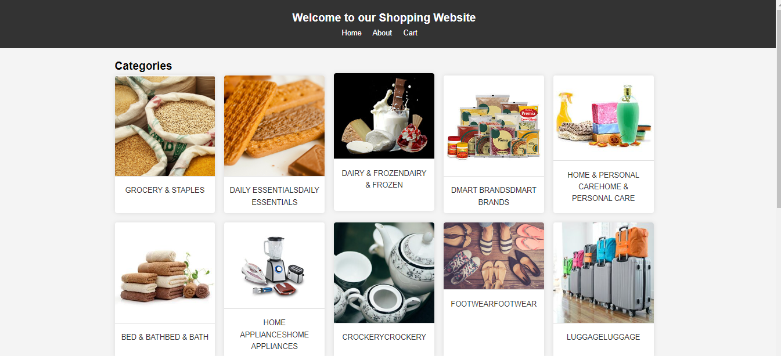
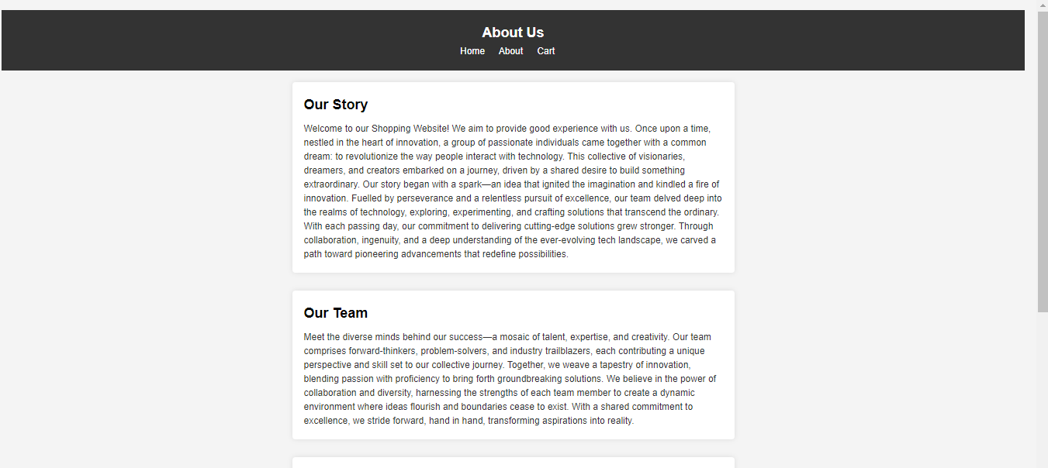
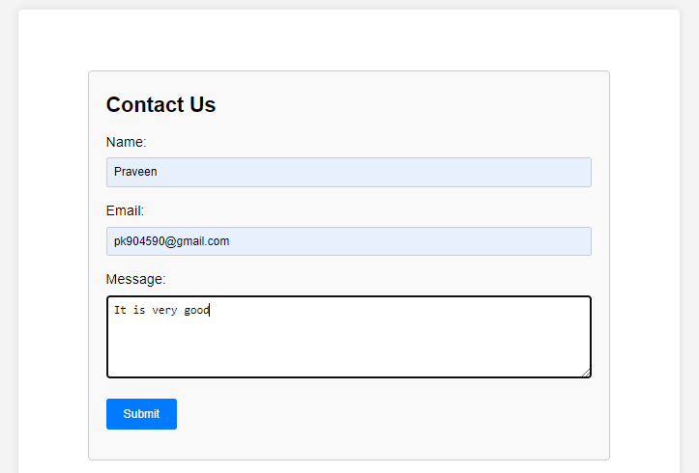
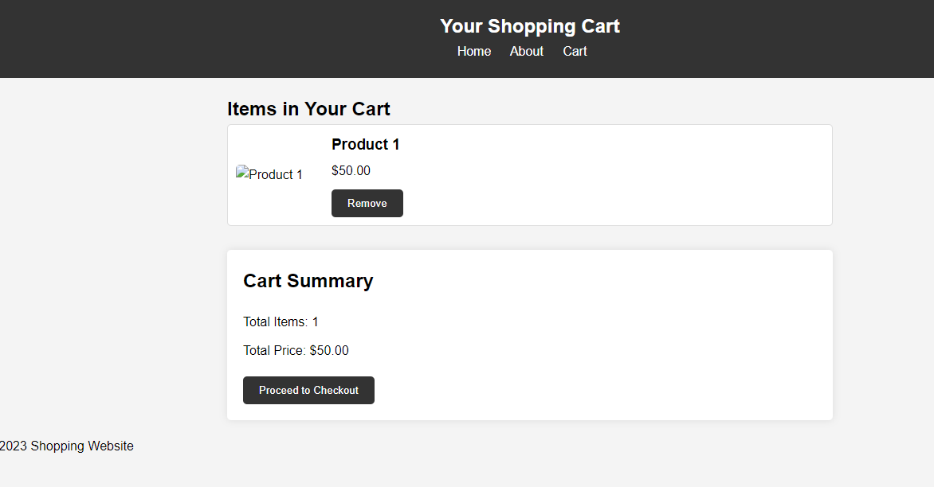

Slide 7
Submission Github
https://github.com/anburajg007/Task5-Link
https://github.com/Prakash-20csa30/Task5-Link
https://github.com/Praveen-20csa31/Task5-Link
https://github.com/vimal50331/Task5-Link

